Slide 1
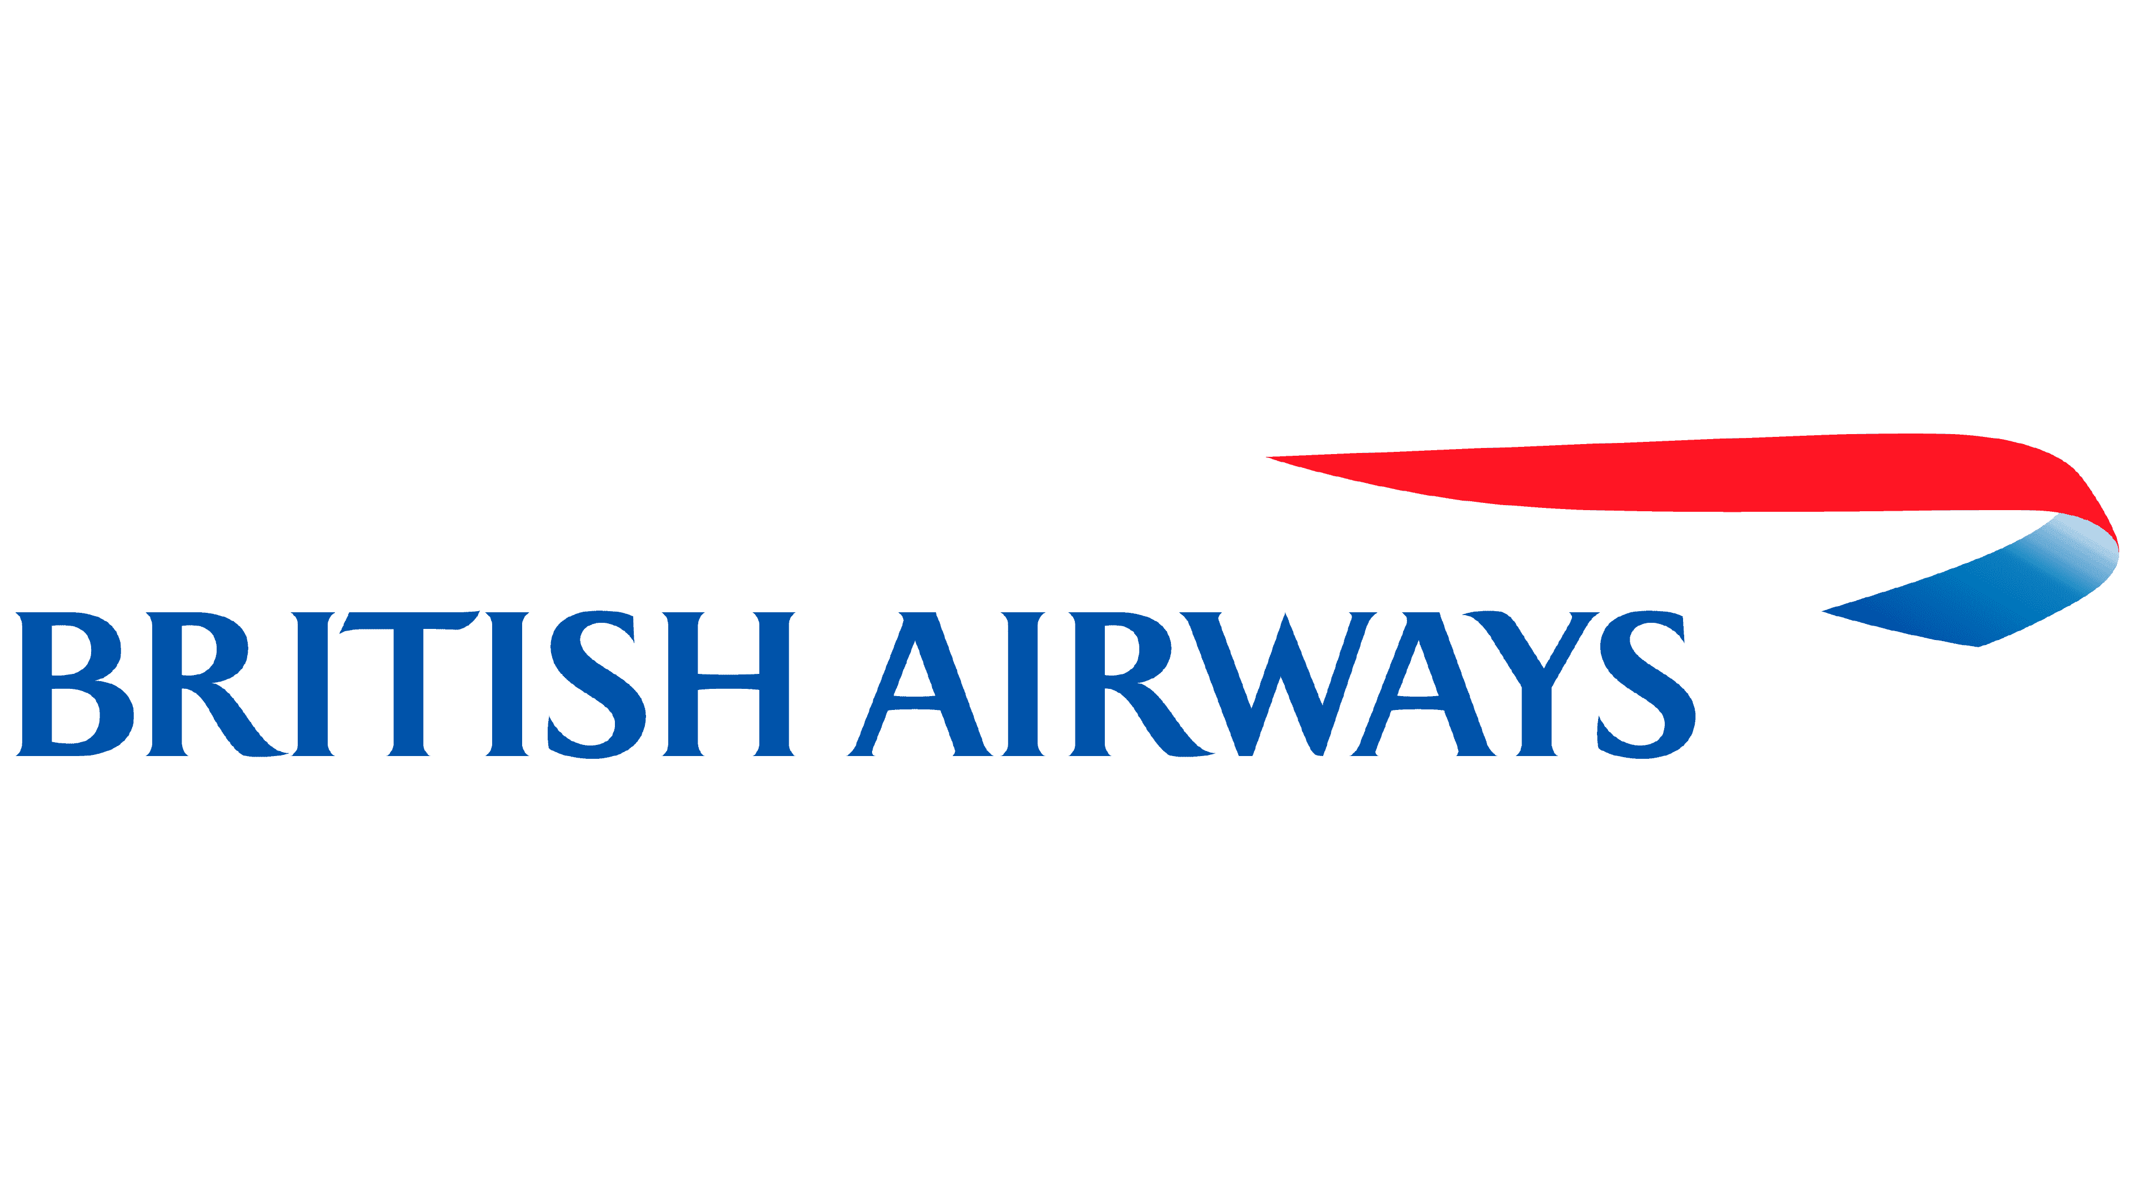
Uncovering Insights from BRITSH AIRWAYS Customer Reviews
Presented by: Ahmed Boulahia

Slide 2
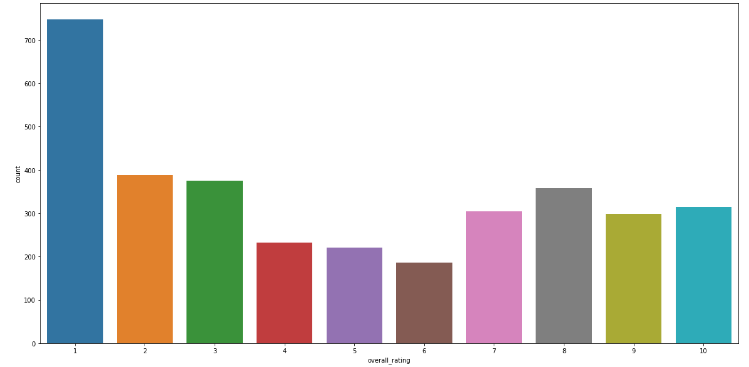
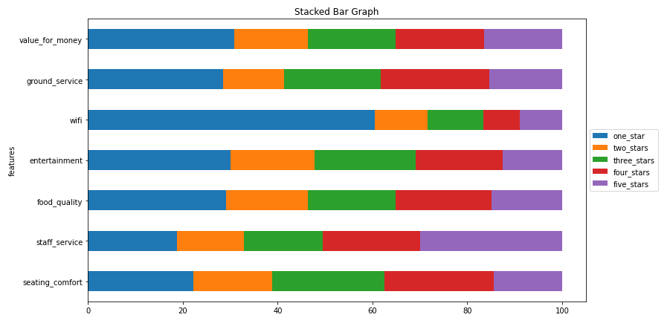
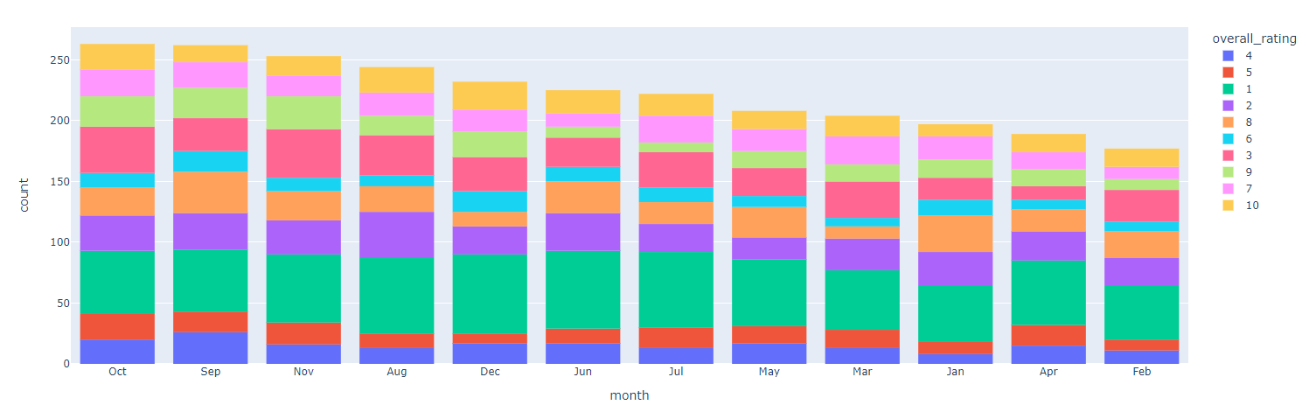
Findings
Study based on
28.35%
21.81% of customers reviewed with 1 star!
😊
Of the reviews are
8 stars or above
3430
Customer reviews
20.76%
😐
Of the reviews are between 5 and 7 stars
More than 57% of customers would
not recommend
British Airways.
50.87%
😡
Of the reviews are 4 stars or under
Reviewers travel class:
Economy Class: 51.19%
Service-Wise Rating Percentage (A Stacked Bar Graph Representation)
Monthly Rating Analysis (Ratings grouped by each month)
Business Class: 33.08%
Premium Economy: 9.87%
Irrespective of the month in question, the distribution of ratings remains largely unchanged, with a consistent predominance of negative evaluations comprising the majority of the total.
First Class:
5.84%
The service with the lowest rating is the WiFi with 60.46% 1-star rating.

